Slide 1
SoC UI screen broken FA Report
Prepared by : PE Long
Date: 2023/11/20

Slide 2
#1
Problems description -1
Issue Description ( 5W2H)
When | 2023/07/27
Who | ALT customer
Where | SK networks warehouse, Anseong, Korea.
What | ALT customer feedback that they found out 1/1000pcs has UI screen is unstable (broken). Defect rate: 1/1000 = 1000 DPPM
Why | Follow SoC material (P/N: 002.02753.005. DC: 2309, Vendor: AMLOGIC)
How | UI screen is unstable (broken).
How many | Total 1pcs (Defect rate: 1/1000 = 1000 DPPM) as below table.
No | Description Issue | S/N | MAC | Fail rate
1 | UI screen is unstable (broken) | 2149688001202301117565 | BCF4D4F8BF3B | 1000 DPPM
Notes:
MA5800-X7#display cable modem <MAC> detail

Slide 3
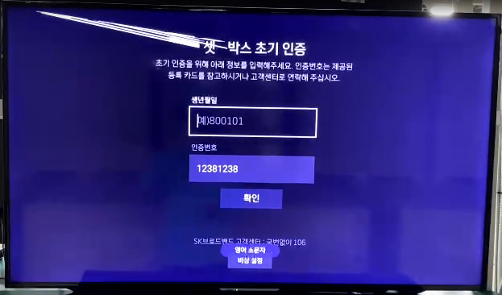
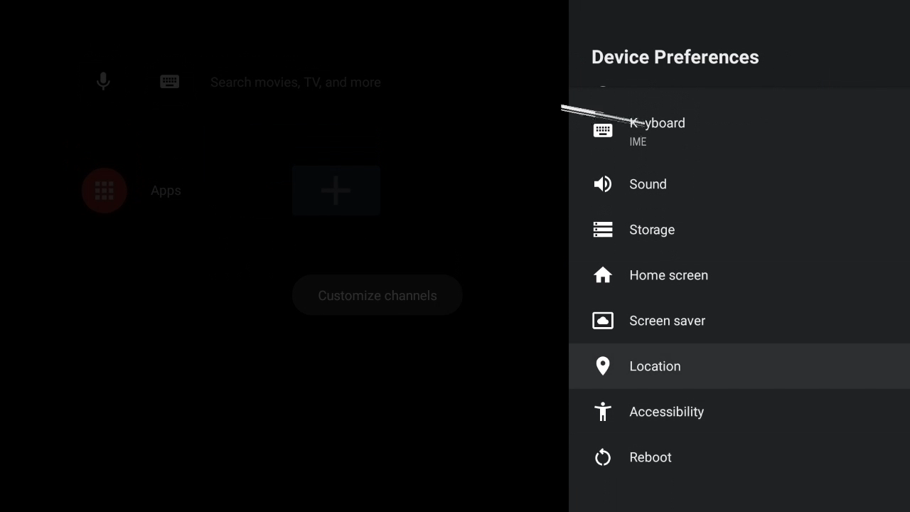
#2
Problems description -2
UI screen is unstable (broken).
Summary:
- UI screen is unstable (broken).
Note: Please watching video
Notes:
MA5800-X7#display cable modem <MAC> detail

Slide 4
#3
S905X2-B Information
1. Detail information as below:
Model Name | BFX-AT100 | Vendor Name | AMLOGIC | Vendor PN | S905X2-B
DPPM | 1000 | Customer | ALT customer | Sample for FA | 1pcs
P/N | 002.02753.005 | Failure Location | U1
Failure symptom | UI screen is unstable (broken).
2. Defective component information as below:
Item | MFG P/N | Lot ID1 | Lot ID2 | Qty
UI screen is unstable (broken). | S905X2-B | PSY662.00 | E22309041N31 | 1

Slide 5
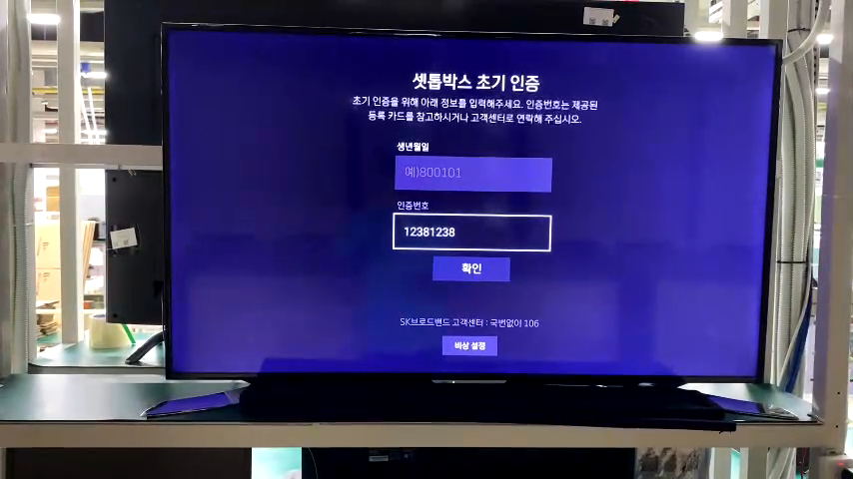
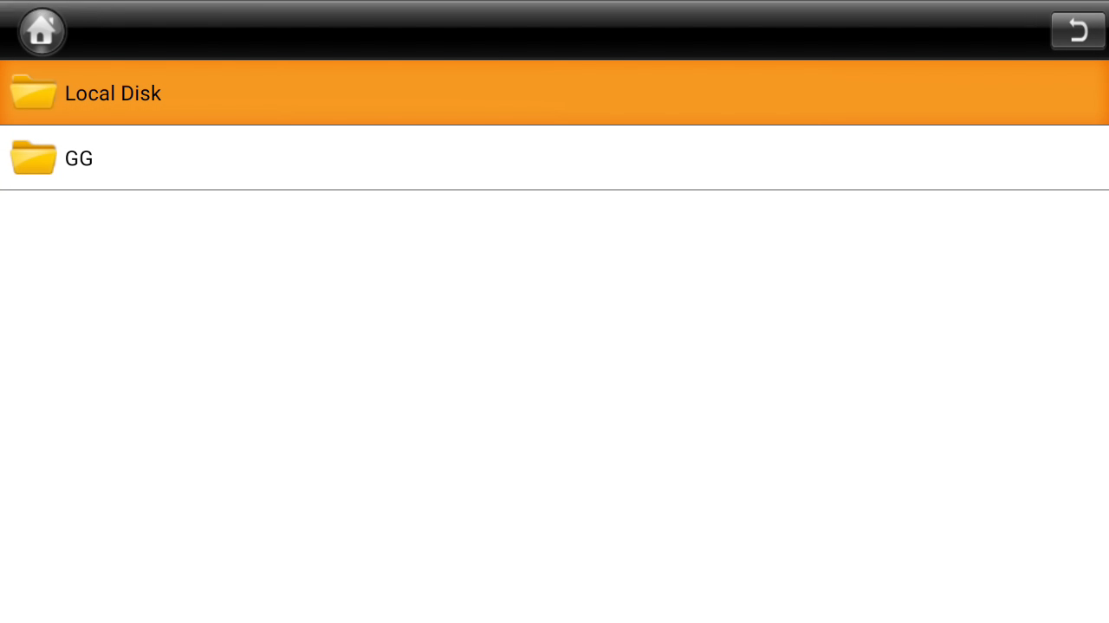
#4
OBA + FATP verify
1. Retest NG sample at OBA station.
UI screen is unstable (broken).
2. Upgrade again factory FW and test NG sample at FT, FT1 station, the result as below:
Screen broken
No. | Station | Result
1 | FT | Pass
2 | FT1 | Pass
Summary: The fail symptom same as customer feedback.
- Retest NG sample at FT, FT1 station ➔ Pass normally.
➔ FATP station can’t cover this issue
Note: Please watching video
Notes:
MA5800-X7#display cable modem <MAC> detail

Slide 6
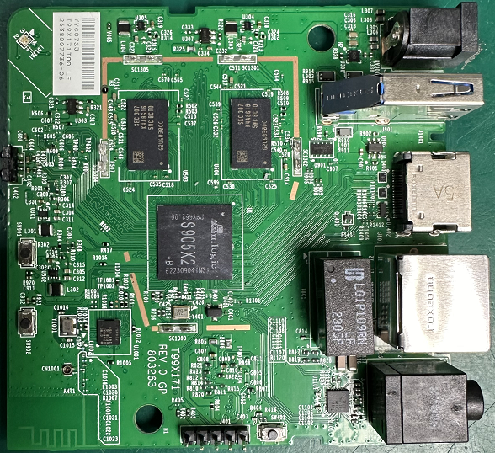
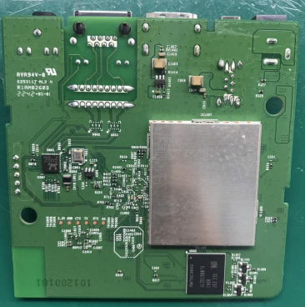
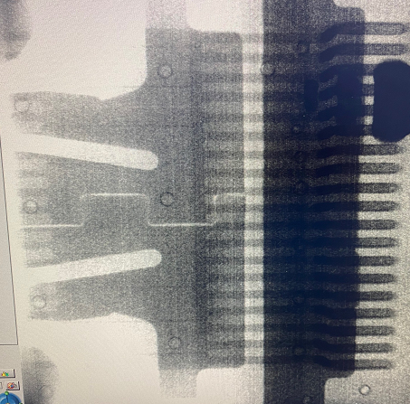

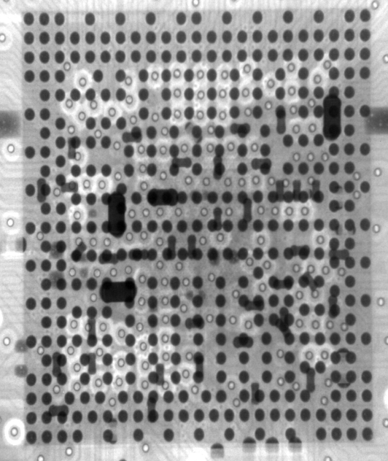
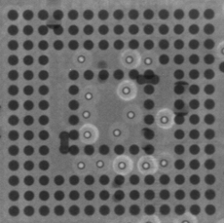
#5
Board Level -1
1. Check Visual inspection and take X-ray NG sample, result as below:
Item | Top side | Bottom side | Result
Visual inspection |  |  | No abnormality
Item | SoC | eMMC | HDMI Connector | Filter | Result
X-ray |  |  |  |  | No abnormality
Summary:
- Check visual inspection and take X-ray ➔ Result: No abnormality
Notes:
MA5800-X7#display cable modem <MAC> detail

Slide 7
#6
Board Level -2
2. Measure impedance /VF on board HDMI connector of NG sample and compare with OK sample, result as table below:
Impedance/VF measurement on board HDMI Connector
Pin No | Pin Name | Description | NG sample |  | OK sample
 |  |  | Impedance (Ω) | VF | Impedance (Ω) | VF
1 | TX2+ | HDMI TMDS data2 negative output | 3.21M | 0.683 | 3.2M | 0.68
2 | TX2_shield | System Ground | 0 | 0 | 0 | 0
3 | TX2- | HDMI TMDS data2 positive output | 3.226M | 0.68 | 3.2M | 0.68
4 | TX1+ | HDMI TMDS data1 positive output | 3.224M | 0.68 | 3.2M | 0.68
5 | TX1_shield | System Ground | 0 | 0 | 0 | 0
6 | TX1- | HDMI TMDS data1 negative output | 3.221M | 0.68 | 3.2M | 0.68
7 | TX0+ | HDMI TMDS data0 positive output | 3.220M | 0.68 | 3.2M | 0.68
8 | TX0_shield | System Ground | 0 | 0 | 0 | 0
9 | TX0- | HDMI TMDS data0 negative output | 3.221M | 0.68 | 3.2M | 0.68
10 | TXC+ | HDMI TMDS clock positive output | 3.215M | 0.68 | 3.2M | 0.68
11 | TXC_shield | System Ground | 0 | 0 | 0 | 0
12 | TXC- | HDMI TMDS clock negative output | 3.21M | 0.68 | 3.2M | 0.68
13 | CEC | General purpose input/output bank H signal 3 | 2.4M | 0.69 | 2.2M | 0.69
14 | NC | Not Connect | NA | NA | NA | NA
15 | SCL | General purpose input/output bank H signal 1 | 1.2M | 0.61 | 1.2M | 0.62
16 | SDA | General purpose input/output bank H signal 0 | 1.11M | 0.61 | 1.01M | 0.61
17 | GND | System Ground | 0 | 0 | 0 | 0
18 | 5V | HDMI_PW | 1.12M | 0.50 | 1.2M | 0.55
19 | HPD | General purpose input/output bank H signal 2 | 110K | 0.69 | 110K | 0.69
Summary: Did not find out abnormal with impedance of NG sample
Notes:
MA5800-X7#display cable modem <MAC> detail

Slide 8
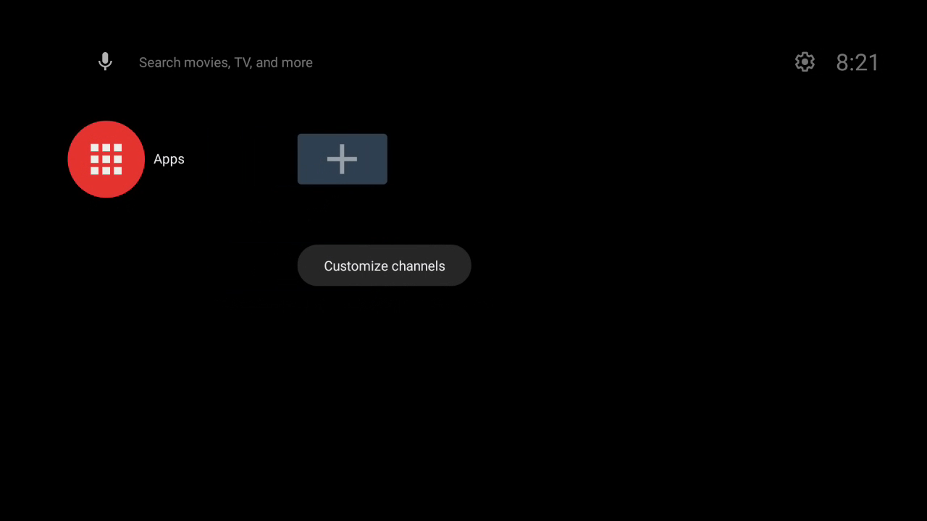
#7
Board Level - 3
3. Change component of HDMI block and retest screen TV. :
- Change new SoC
➔ Result: Pass 5/5 times. This issue follow SoC component.
TV screen OK
Summary:
- This issue follow SoC (P/N: 002.02753.005, DC: 2309, Vendor: AMLOGIC) material have issue.
Note: Please watching video
Notes:
MA5800-X7#display cable modem <MAC> detail

Slide 9
#8
Component level - 1
1. Removed SoC and measure HDMI block pin, result as table below:
SoC-U1 HDMI pin impedance measurement
SoC_PIN NAME | Description | OK SoC Sample |  | NG SoC sample
 |  | Impedance | VF | Impedance | VF
C43 | HDMI TMDS data2 negative output | 8.81MΩ | 0.76 | 8.56MΩ | 0.767
C45 | HDMI TMDS data2 positive output | 8.71MΩ | 0.76 | 8.56MΩ | 0.767
E45 | HDMI TMDS data1 positive output | 8.61MΩ | 0.76 | 8.57MΩ | 0.766
G43 | HDMI TMDS data1 negative output | 8.61MΩ | 0.76 | 8.56MΩ | 0.766
J41 | HDMI TMDS data0 positive output | 8.65MΩ | 0.76 | 8.45MΩ | 0.764
J43 | HDMI TMDS data0 negative output | 8.63MΩ | 0.76 | 8.43MΩ | 0.764
L43 | HDMI TMDS clock positive output | 8.54MΩ | 0.76 | 8.33MΩ | 0.763
L45 | HDMI TMDS clock negative output | 8.64MΩ | 0.76 | 8.33MΩ | 0.763
N41 | General purpose input/output bank H signal 1 | 2.52MΩ | 0.71 | 2.69MΩ | 0.721
N43 | General purpose input/output bank H signal 3 | 2.64MΩ | 0.75 | 2.70MΩ | 0.746
R43 | General purpose input/output bank H signal 0 | 2.49MΩ | 0.71 | 2.655MΩ | 0.724
R45 | General purpose input/output bank H signal 2 | 2.61MΩ | 0.74 | 2.694MΩ | 0.729
AG45 | General purpose input/output bank H signal 4 | 2.91M | 0.78 | 3.182MΩ | 0.788
Summary: Measure impedance/VF HDMI pins of NG SoC ➔ Did not find out any abnormality
Notes:
MA5800-X7#display cable modem <MAC> detail

Slide 10
#9
Component level - 2
2. Reball and do a swap verification SoC
Check Screen HDMI | 1 | 2
OK board + OK SoC | OK | OK
NG board + NG SoC | NG | NG
OK board + NG SoC | NG | NG
NG broad + OK SoC | OK | OK
Summary:
- As analyzed above this issue follow U1-SoC( P/N: 002.2753.005, DC: 2309, Vendor: AMLOGIC ) component.
Notes:
MA5800-X7#display cable modem <MAC> detail

Slide 11
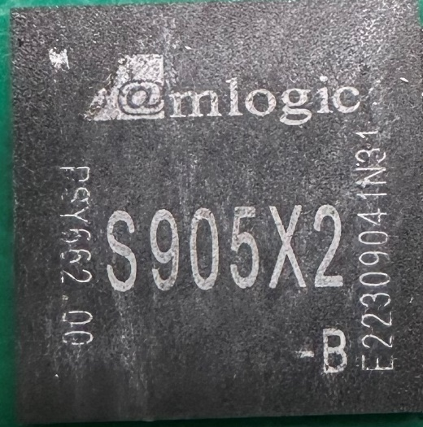
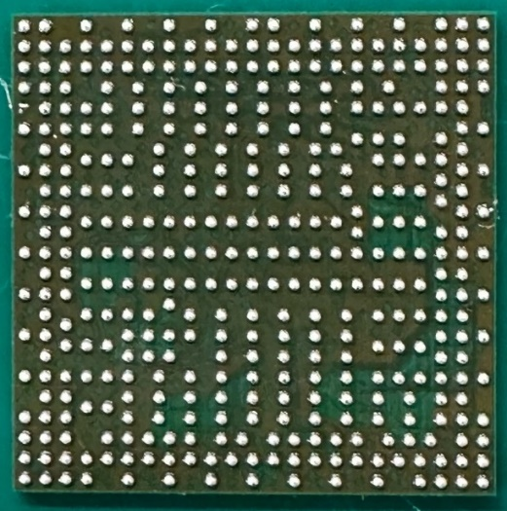
#10
VI Component
1. Reball and check VI top & Bot side of the component:
Top side | Bot side
Summary:
VI NG sample will send to SQE ➔ Don’t find out any abnormal.
Notes:
MA5800-X7#display cable modem <MAC> detail

Slide 12
#11
Corrective Action
Root cause:
- Occur cause: Follow U1 SoC (P/N: 002.02753.005, DC: 2309, Vendor: AMLOGIC) have material issue.
- Escape cause: FATP can’t cover issue.
Short term:
Send FA report and NG SoC material to vendor AMLOGIC for futher analyzing and taking action for this issue. Owner: SQE Naomi. Due date: 20-Nov.
Waiting vendor feedback : Owner: SQE Naomi. Due date: 18-Dec-2023.
Notes:
MA5800-X7#display cable modem <MAC> detail

